Slide 1



Explore the Population Change
of China
Yao Yuheng
2024.10.18
G2405427G

Slide 2

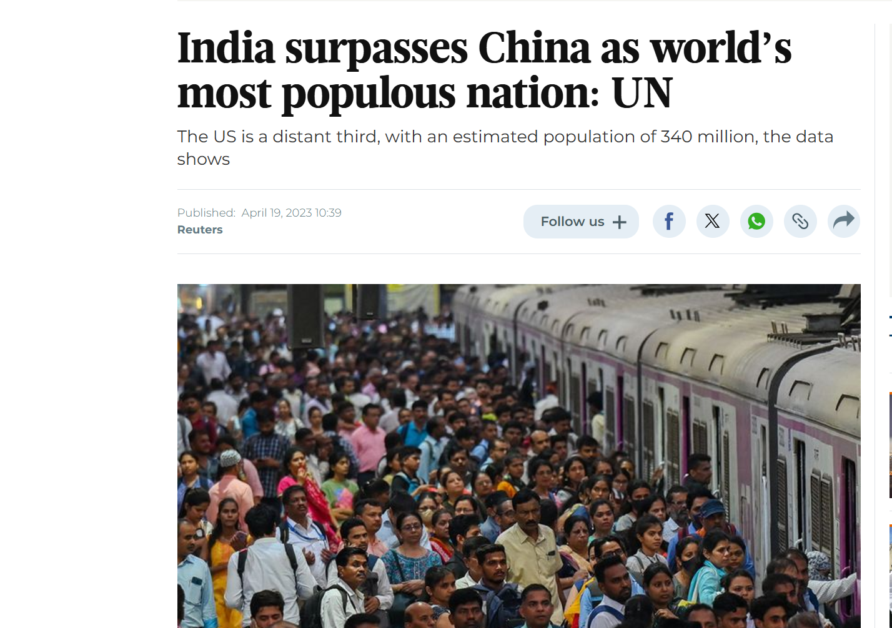
The global population has been growing rapidly in recent centuries. China has alway been a large country with massive population. In the memory of Chinese people born in the 2000s, China has always been the most populous country in the world and its population is still growing.
until....

Slide 3

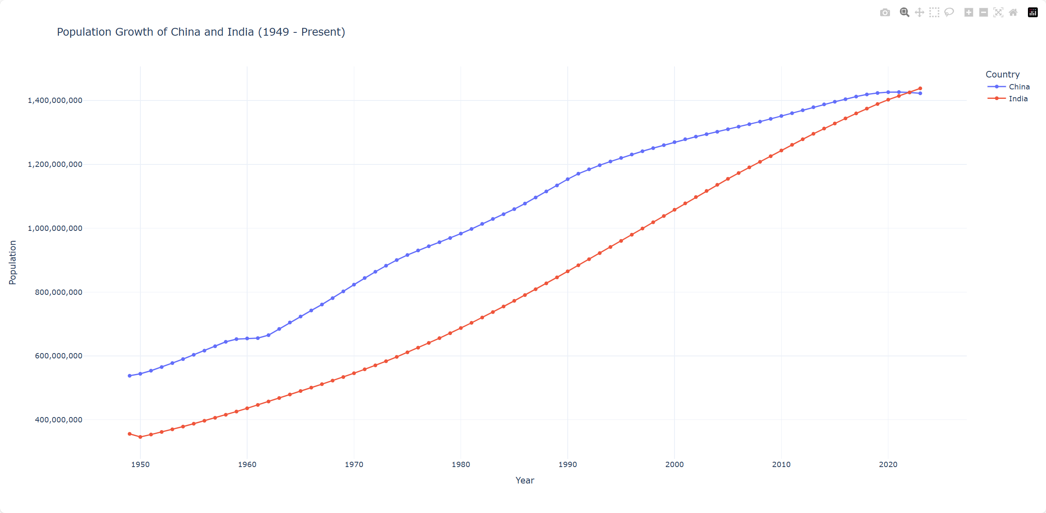
What happened to the population?
The pace of growing slowed already?
When?
the increasing rate vanished!

Slide 4
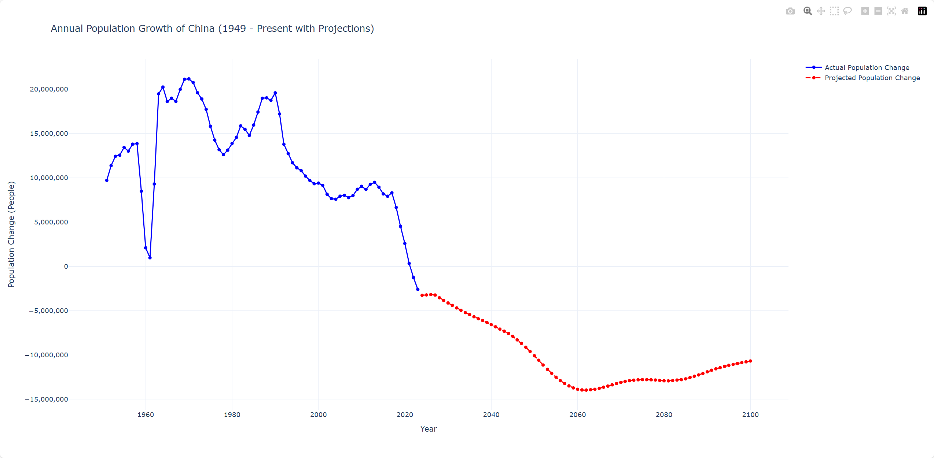

the pace has already slowed since 2017!
Let’s take a look at the annual growth of Chinese population
the growth stopped completely??
something happened much earlier than we thought...
what happened in since 2017?

Slide 5
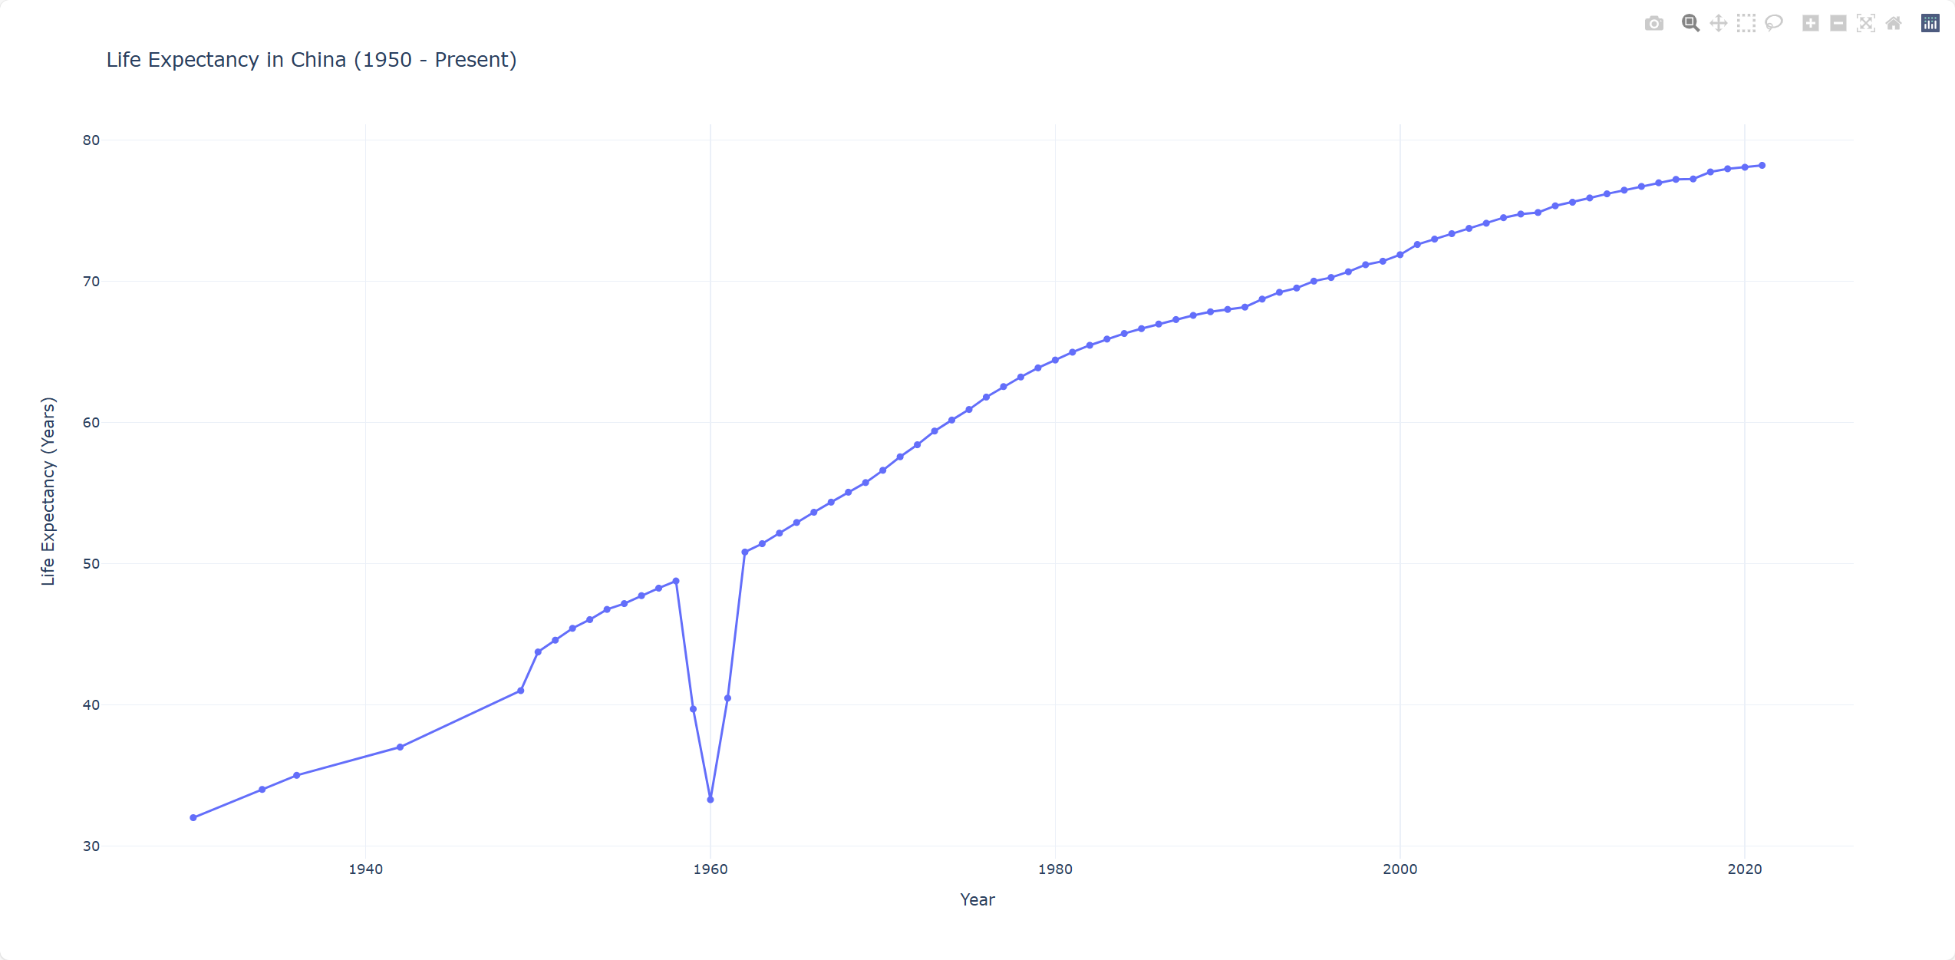
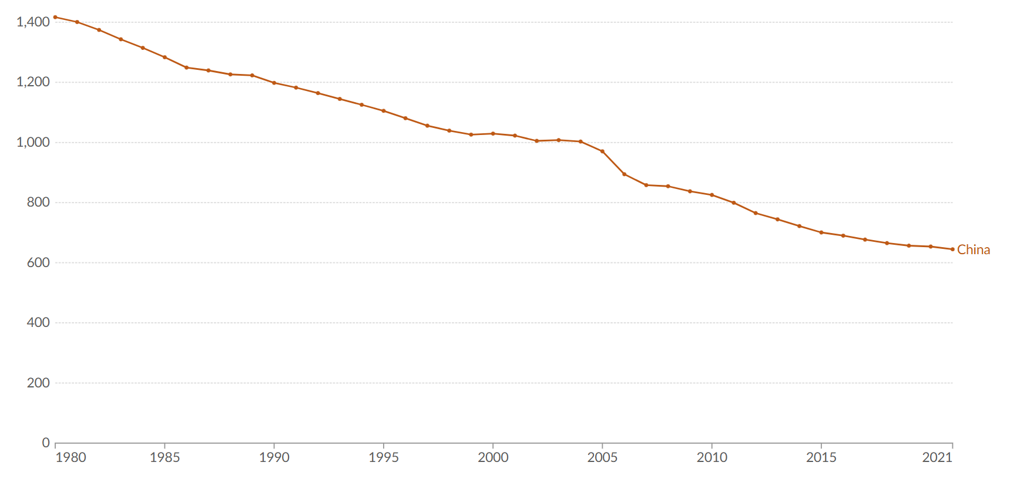
think about the formula: $annual growth = annual birth − annual death$
Annual death rate from all causes
the death rate is actually droping, Chinese people live for a longer life. the problem is the birth rate.

Slide 6
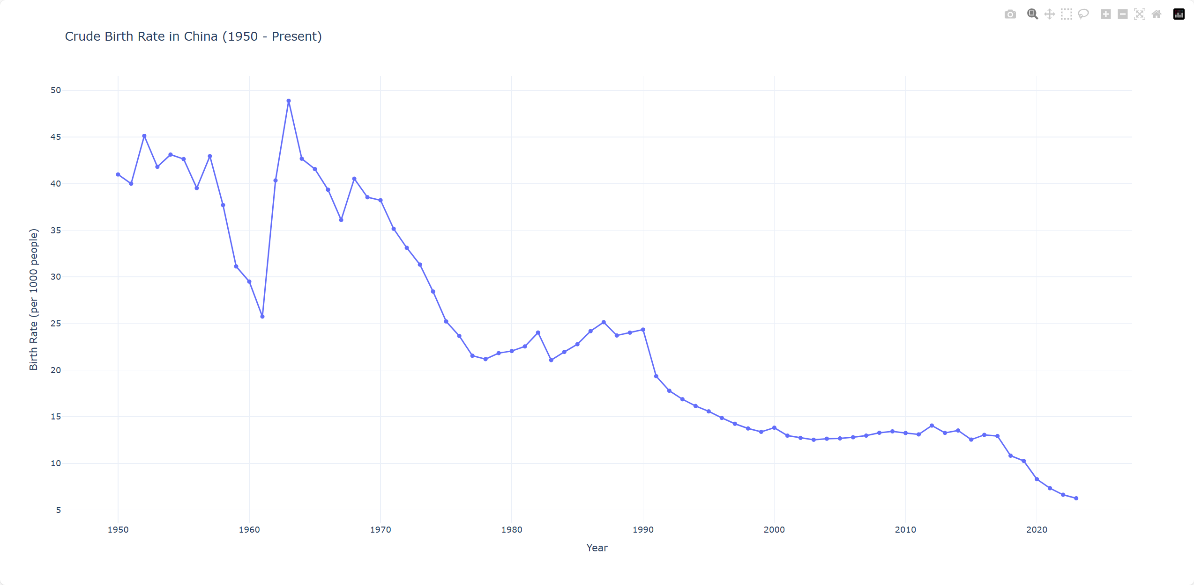
think about the formula: $annual growth = annual birth − annual death$
As we can see, the birth rate began to drop since 2017.
2017

Slide 7







Why the birth rate drop dramatically since 2017?
Think about the pocess of birth:
MARRIAGE
Is there something wrong with the marriage rate? Or are new couple giving less birth?
FERTILITY

Slide 8

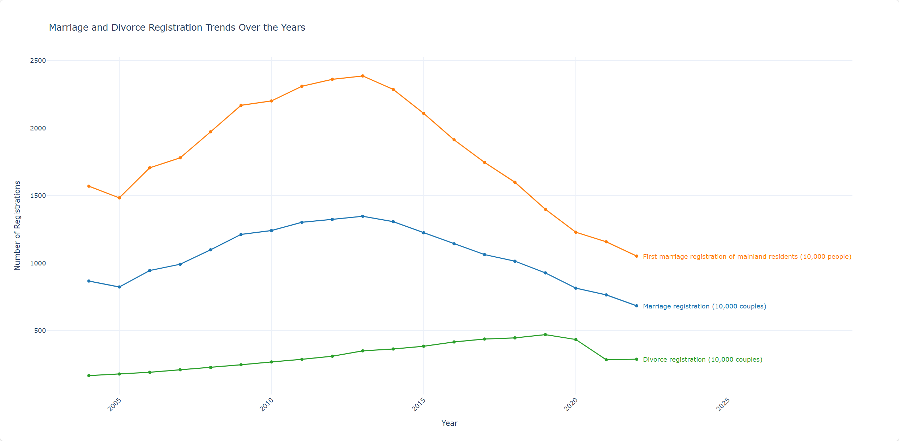
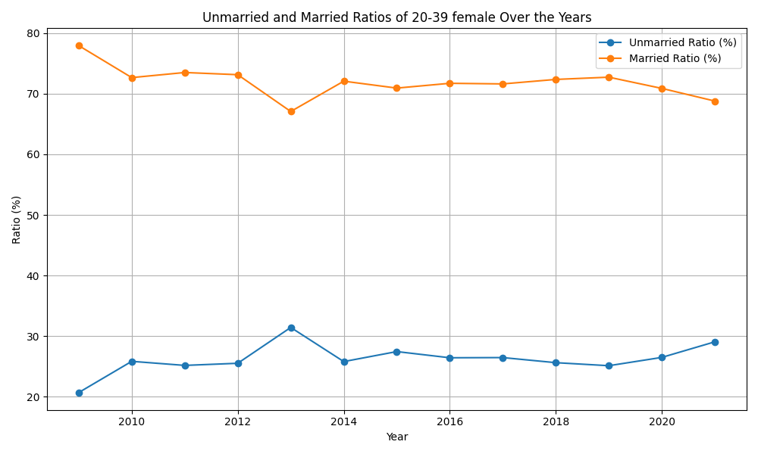
Less and less young adults get married
Both the marriage registration and first marriage has been decreasing since 2013 and all the way down to 2022.
As a result, single rate goes up now
Unmarried

Slide 9
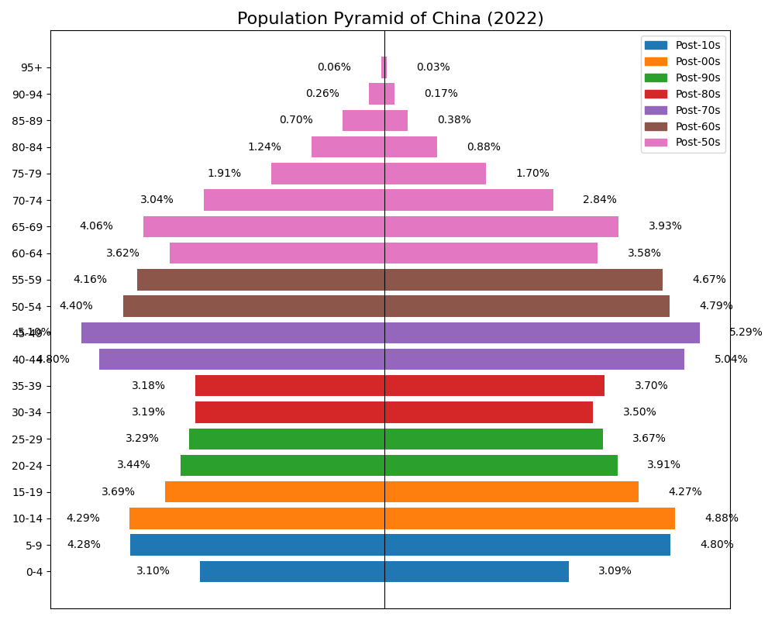
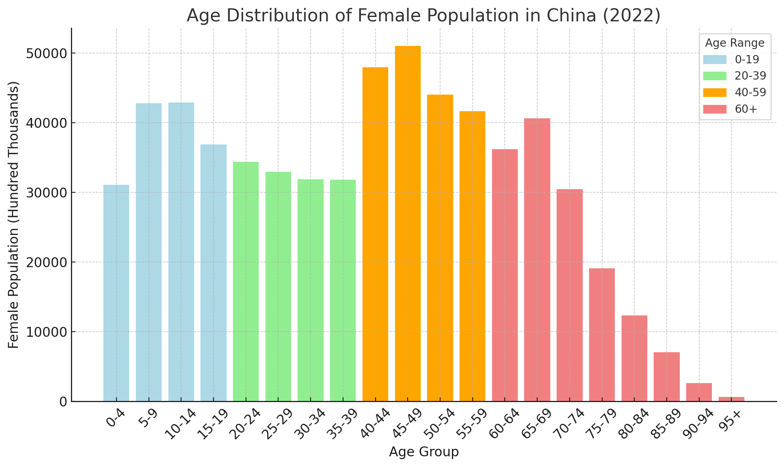
Why people don’t getted married these days?
1.the total number of childbearing age people is shrinking, which is pretty like a vicious cycle
As we can see, the population between 20-39
is significantly fewer than population between 40-59,which means the group of childbearing age people has shrinked.
population gap

Slide 10
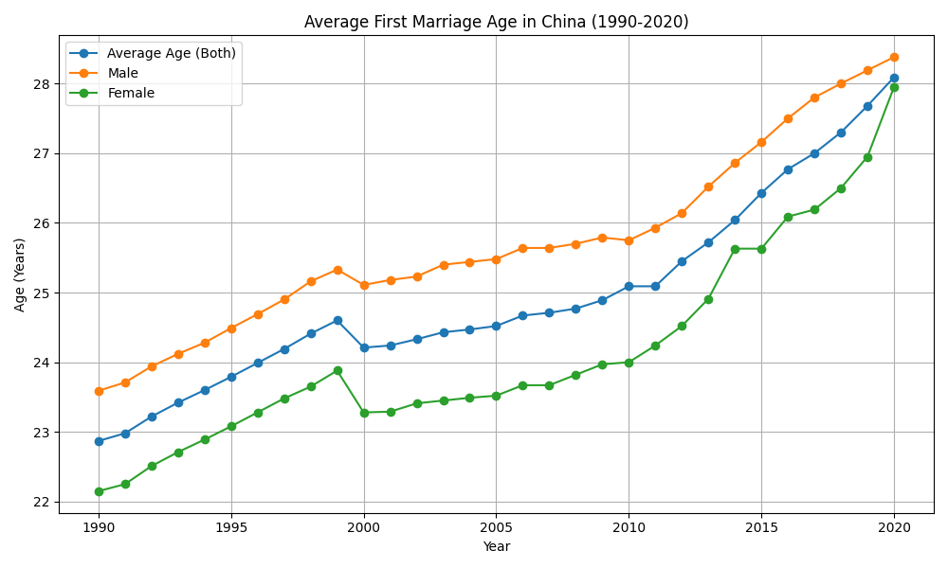
why people don’t getted married these days?
2.People delay their first marriage over the year
As the improvement of education level and economic independence, people realize the opportunity cost of marriage. The marriage concept of the younger generation has changed.
This is very clear in the picture that the average age of first marriage is increasing steedily as the year goes by.

Slide 11
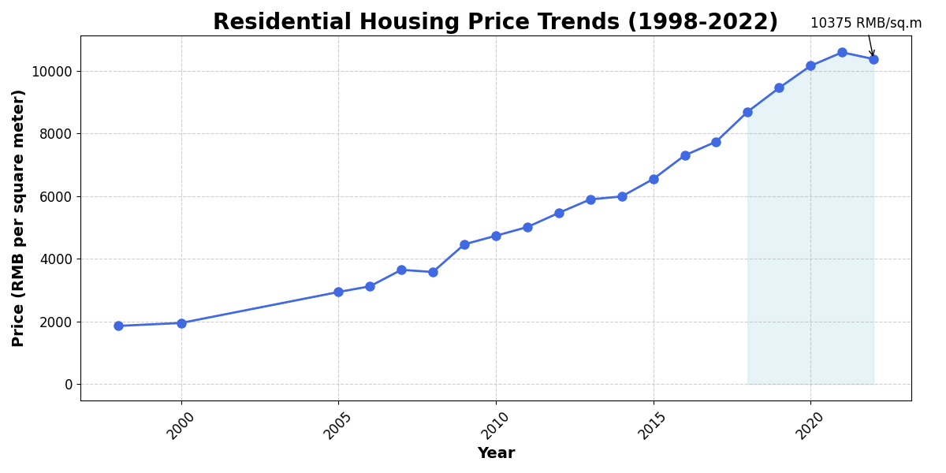
why people don’t getted married these days?
3.the high housing price in the cities makes marriage difficult for young adults.
The housing price has always been raising...
But so does the imcome, right?

Slide 12
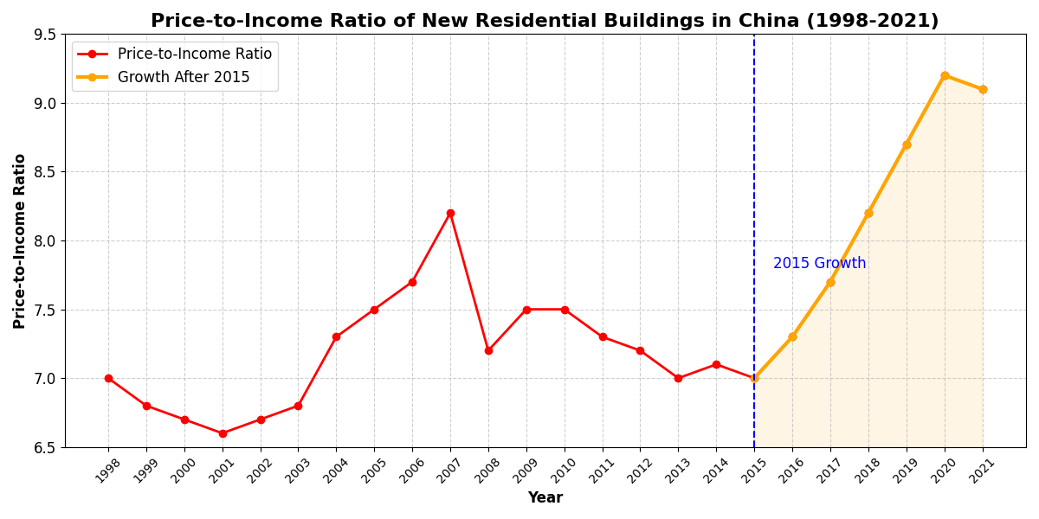
$$price/income = \frac{residential unit price × housing area per capita}{disposible income}$$
CONCEPT:
roughly how many years it takes to buy a house
it surge rapidly since 2015 and finally stopped at a high place in 2020.
but is it a large number?

Slide 13
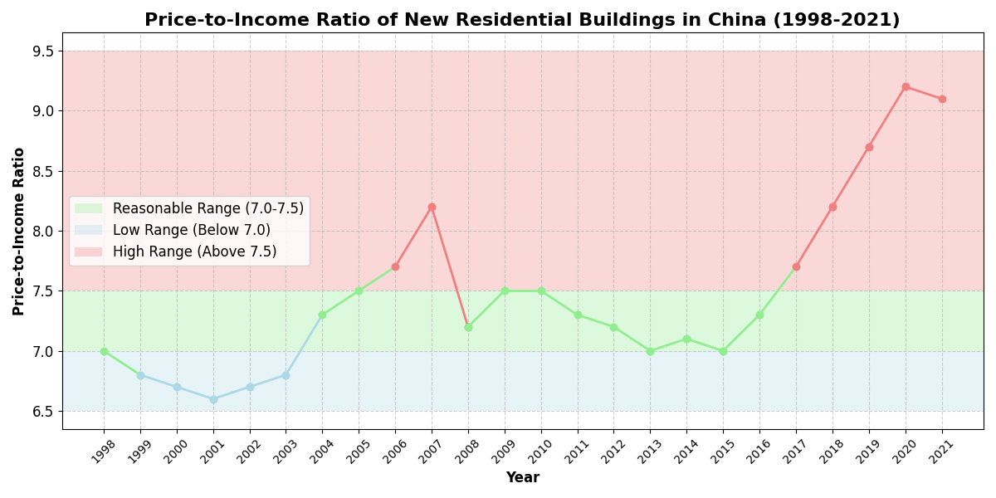
why people don’t getted married these days?
According to 2021 National House Price to Income Ratio Report, “the national housing price to income ratio is in
the reasonable range of 7.0-7.5, below 7.0 is in the low range, and above 7.5 is in the high range”
the housing burden became overwhelming
since 2017.

Slide 14
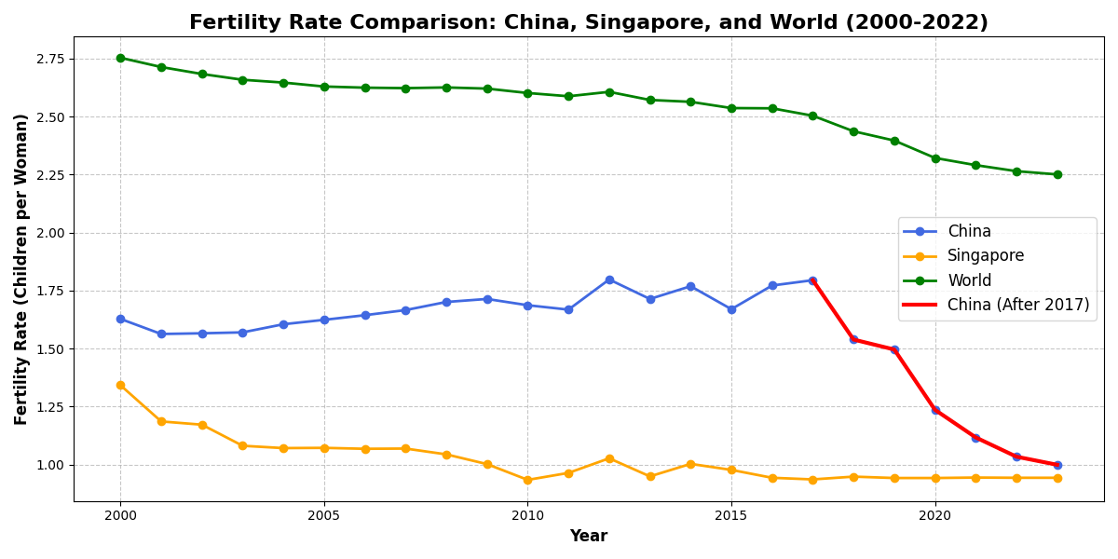
The Chinese family is also shrinking.
Why？
2017 turning point

Slide 15

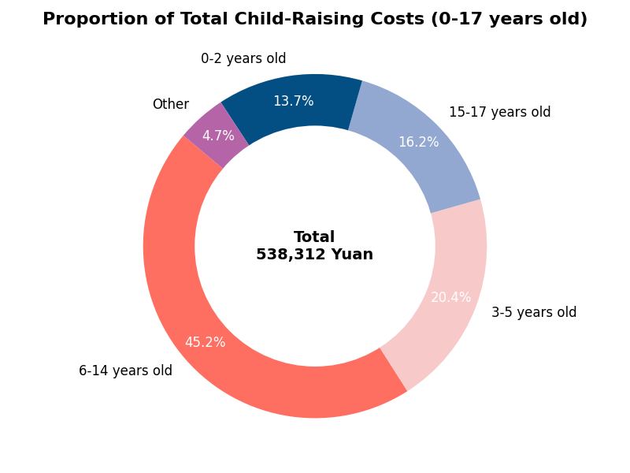
Raising a child is expensive
According to the China Fertility Cost Report 2024,The top reason why women of childbearing age do not plan to have more children is "heavy financial burden".
The median of disposable income per capita is 30,598.3 yuan by the way.

Slide 16
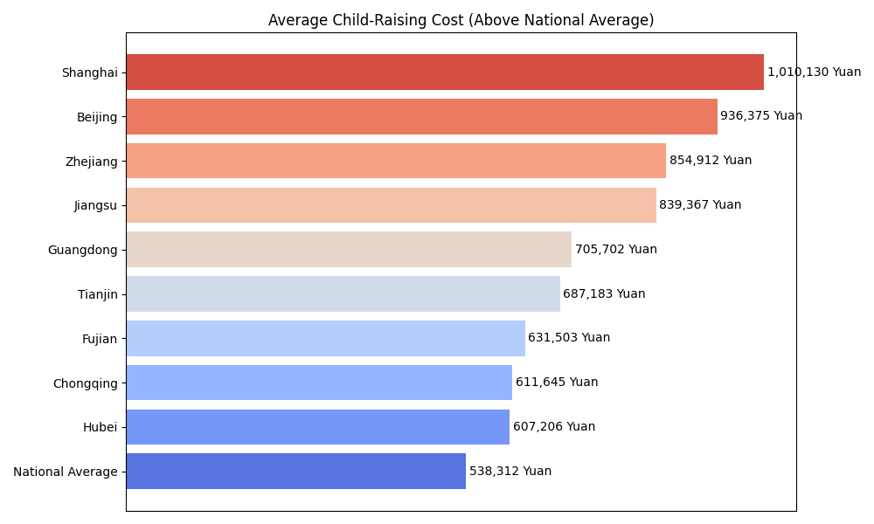
The cost is even higher in big cities
The cost doubles in Beijing and Shanghai

Slide 17
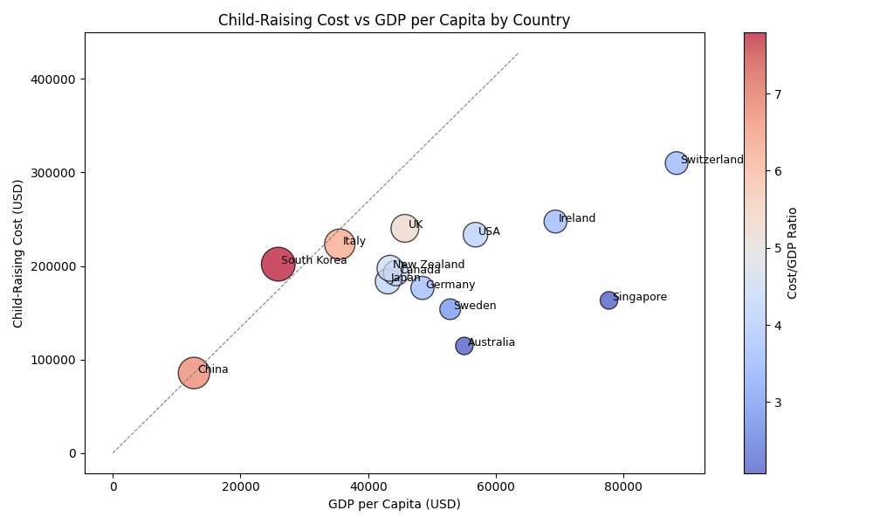
When compared in the world
It’s among the top, slightly lower than Korea...

Slide 18
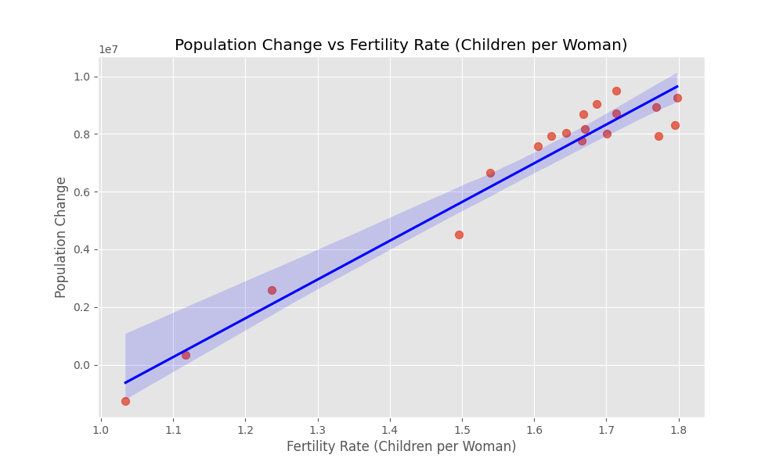
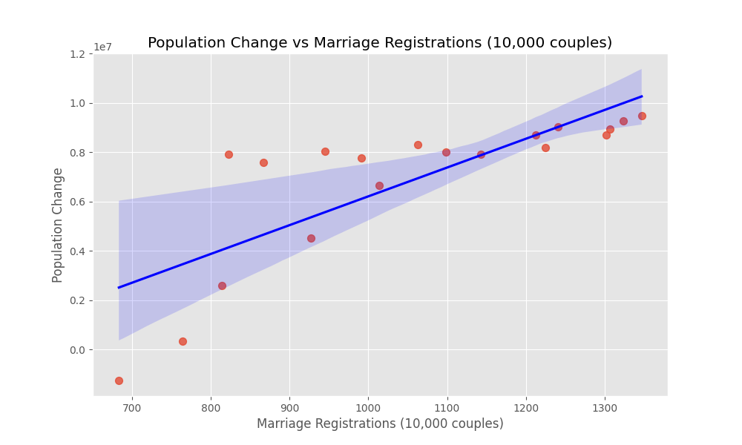
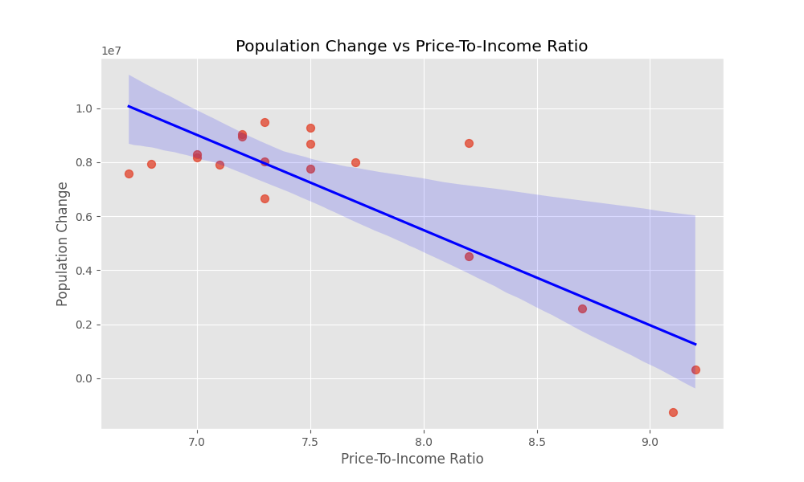
One final thing, does the analysis make any sense?Let the models speak for me！

Slide 19
Conclusion
China's population maintained a high growth rate until 2017
China's birth rate plummets despite rising life expectancy
The number of marriages among young Chinese has dropped significantly, due to the decrease in the number of people of marriageable age,
the postponement of first marriages and,
extremely high housing prices,
China's fertility rate falls due to huge child-rearing costs

Slide 20
Reference
[1]HYDE (2023); Gapminder (2022); UN WPP (2024) – with major processing by Our World in Data
[2]China National Bureau of Statistics. (2023). China Statistical Yearbook 2023. Retrieved from https://www.stats.gov.cn/sj/ndsj/2023/indexch.htm
[3]Hannah Ritchie, Lucas Rodés-Guirao, Edouard Mathieu, Marcel Gerber, Esteban Ortiz-Ospina, Joe Hasell, and Max Roser (2023). "Population Growth" published at OurWorldinData.org.
[4] Max Roser (2014). "Fertility Rate" published online at OurWorldinData.org.
[5]He, D., Zhang, X., Zhuang, Y., Wang, Z., & Yang, S. (2018). China Fertility Status Report, 2006-2016: An Analysis Based on 2017 China Fertility Survey. Population Research, 42(6), 35-45.
[6]Liang, J., Ren, Z., Huang, W., He, Y., & Yu, J. (2023). China Marriage and Family Report 2023 Edition. Yuwa Population Research, August 2023.
[7]E-house Research Institute. (2022). 2021 National House Price to Income Ratio Report. E-house Research Series.
[8]Liang, J., Huang, W., & He, Y. (2024). China Fertility Cost Report 2024 Edition. Yuwa Expert Team, February 2024.
[9]China National Development and Strategy Institute, Renmin University of China, Urban Renewal Research Center. (2022). Housing Report 2022: Insights from China’s Seventh Census on Urban Housing Development.

